Slide 1
Functional programming in Java 8 Part 4 – Optional and Primitive Streams
Stav Alfi

Slide 2
Pre Requirements
Functional Programming in Java 8 - Part 1 - Basic Concepts & Lambdas
Functional Programming in Java 8 - Part 3 - Java Streams - Introduction

Slide 3
Agenda
Step back - Functional Interfaces Family
Optional Class
Primitive Streams

Slide 4
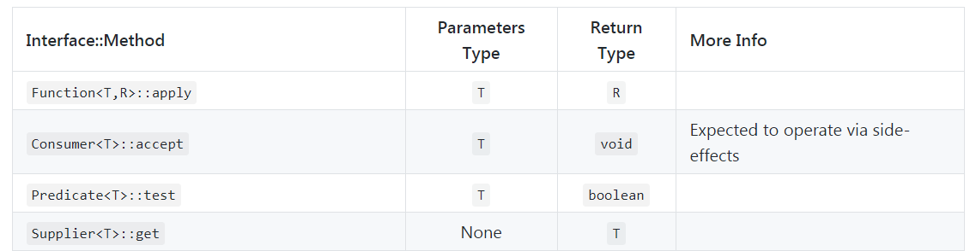
Step back - Functional Interfaces Family

Slide 5
Step back - Functional Interfaces Family

Slide 6
Step back - Functional Interfaces Family

Slide 7
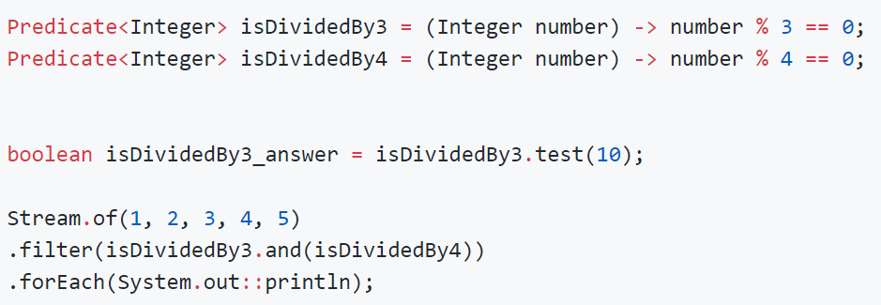
Step back - Functional Interfaces Family

Slide 8
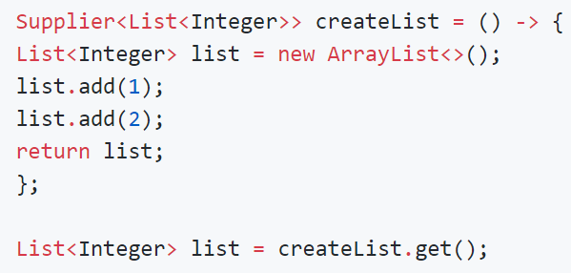
Step back - Functional Interfaces Family

Slide 9
Optional Class
NullPointerException
Optional class- Construction
Optional class methods

Slide 10
Native solutions for Async streams in Java
Amount of elements/Is Async | Synchronous | Async
0...1 | Future Optional | CompletableFuture
0…Infinity | Java Streams | Reactive Streams
Session 4
Session 5
Session 3

Slide 11
Optional Class - NullPointerException
Represent 0..1 elements
Reasons for NullPointerException.
When should we return null?

Slide 12
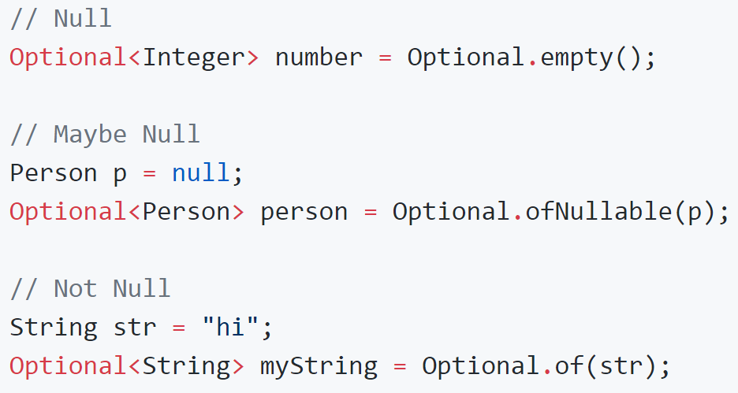
Optional Class - Construction

Slide 13
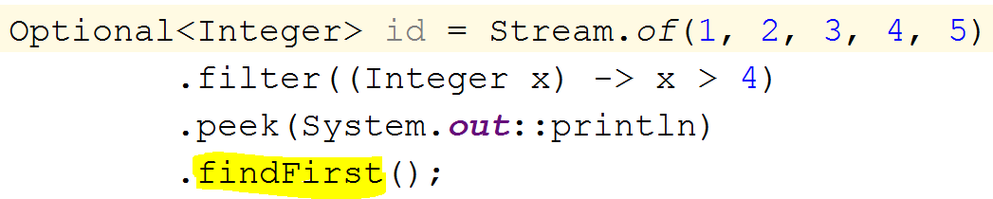
Optional Class - Construction

Slide 14
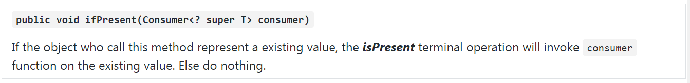
Optional Class - Methods

Slide 15
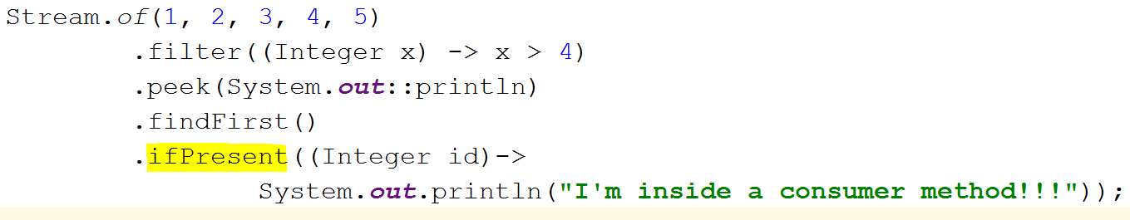
Optional Class - Methods

Slide 16
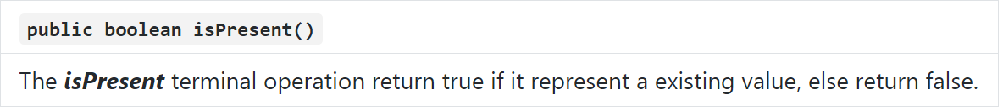
Optional Class - Methods

Slide 17
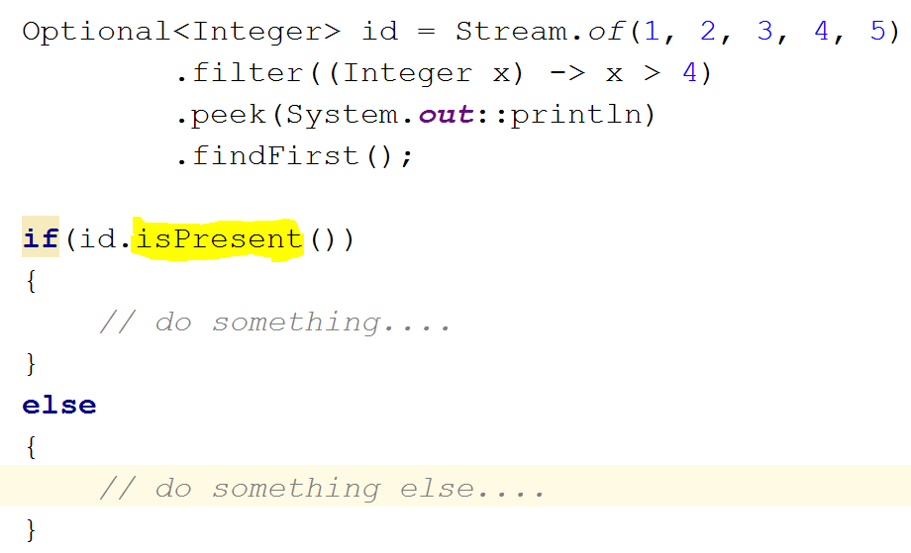
Optional Class - Methods

Slide 18
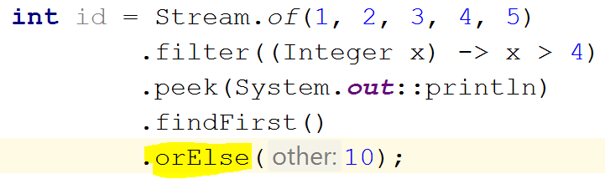
Optional Class - Methods

Slide 19
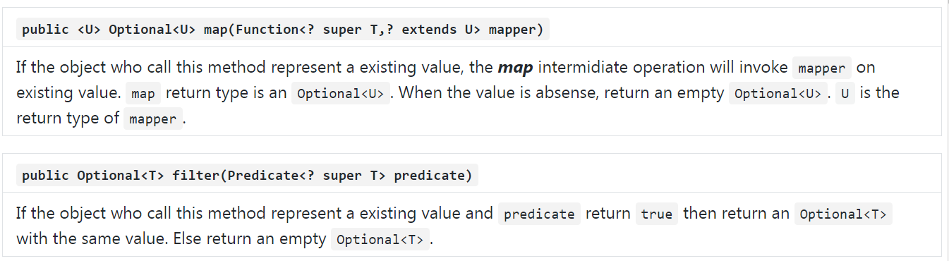
Optional Class - Methods

Slide 20
Optional Class - Conclusion
Should we declare null as parameter?
When should we return null?

Slide 21
Primitive Streams
What?
Why?
How?
Primitive streams methods.

Slide 22
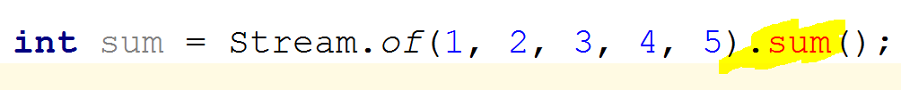
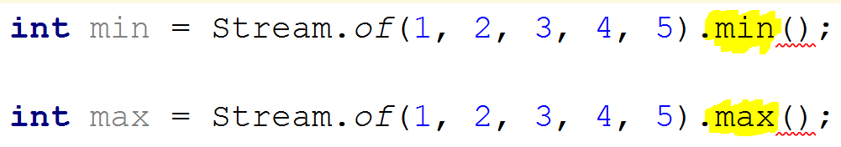
Primitive Streams – why?

Slide 23
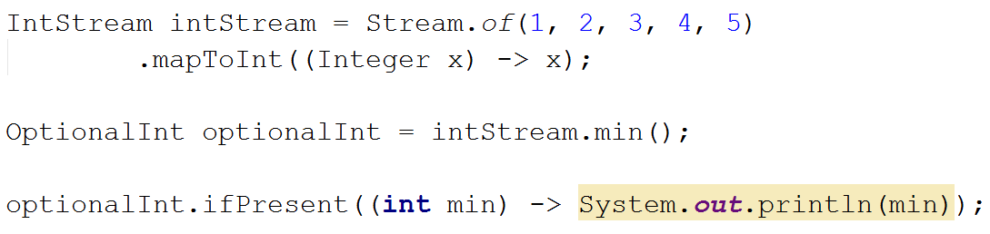
Stream to Primitive Stream?

Slide 24
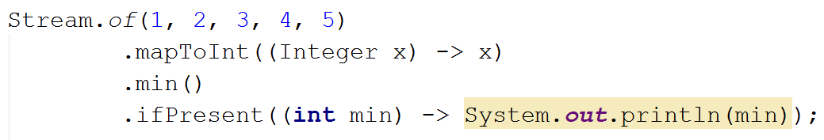
Stream to Primitive Stream?

Slide 25
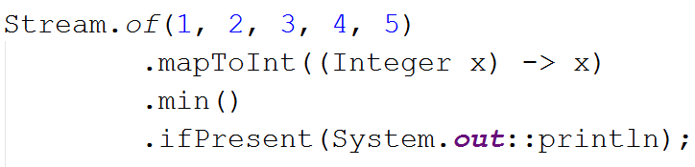
Stream to Primitive Stream?

Slide 26
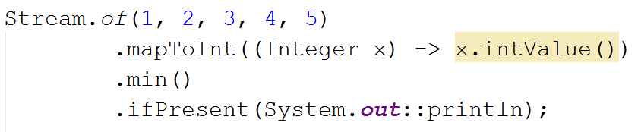
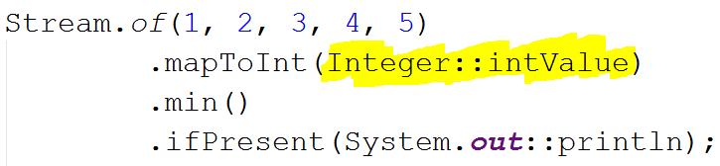
Stream to Primitive Stream?

Slide 27
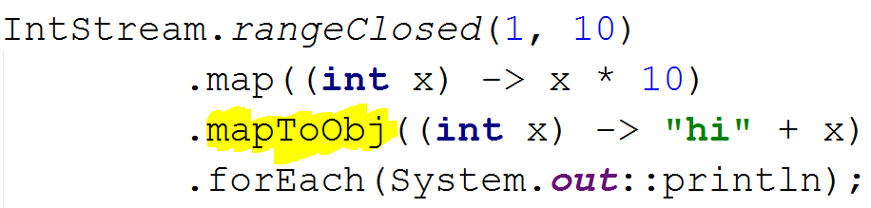
Primitive Stream to Stream?

Slide 28
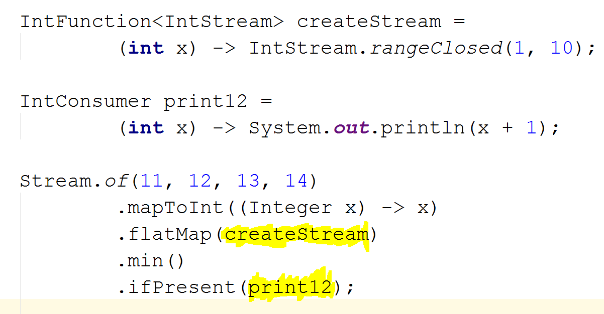
Exercise

